Slide 1
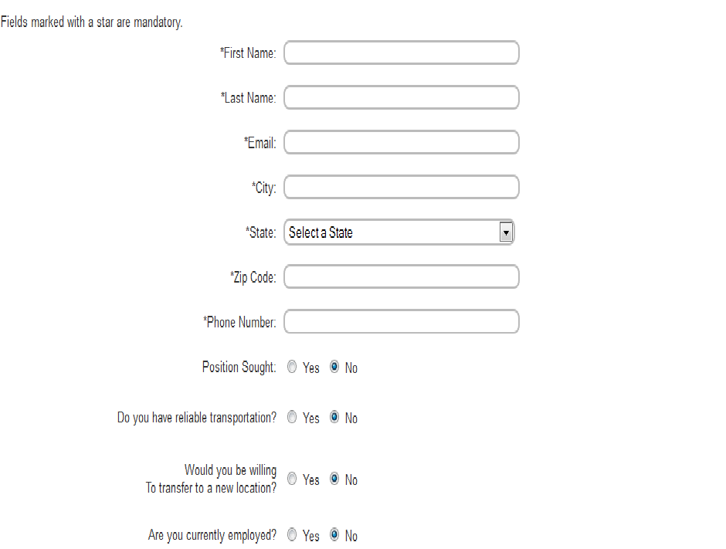
Intro Paragraph which includes the benefits of working at American Freight such as paid vacation and advancement opptunities along with hyper link to career builder. profile
Apply Online - American Freight:
Available Positions
Management Trainee - American Freight Birmingham, AL
Sales Cleveland, OH
Data Entry/Clerical Delaware Ohio
ATTENTION WAITRESSES & WAITERS!
South Bend, IN
ATTENTION WAITRESSES & WAITERS!
Birmingham, AL

