Slide 1
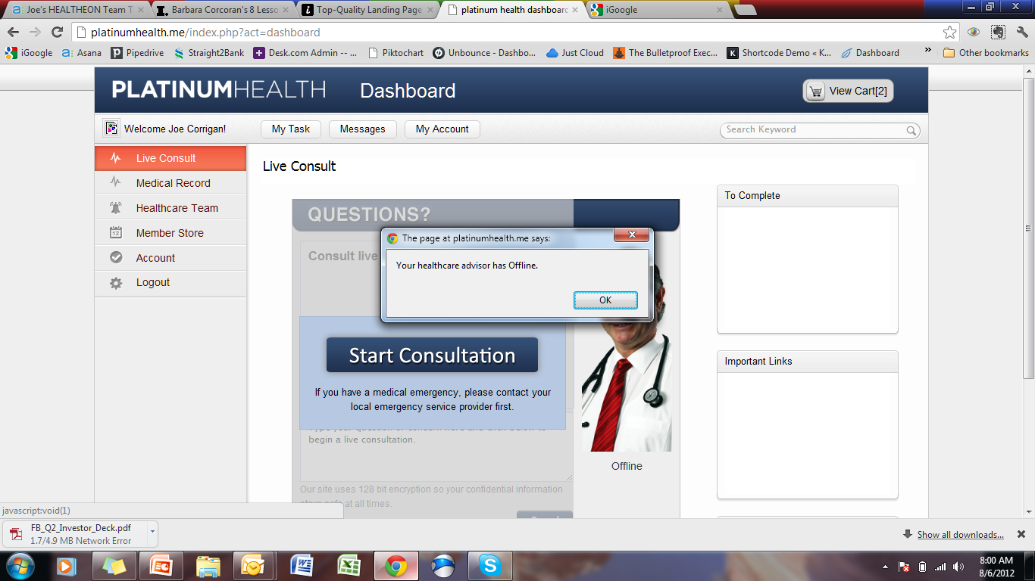
? Completed
Lets discuss these.
I think other than ‘My Tasks’ the rest are unnecessary. Completed
Change copy ref: email
Changed alert message to
Your healthcare advisor is current engaged with a patient. Please wait a moment or complete the consultation questionnaire.

Slide 2
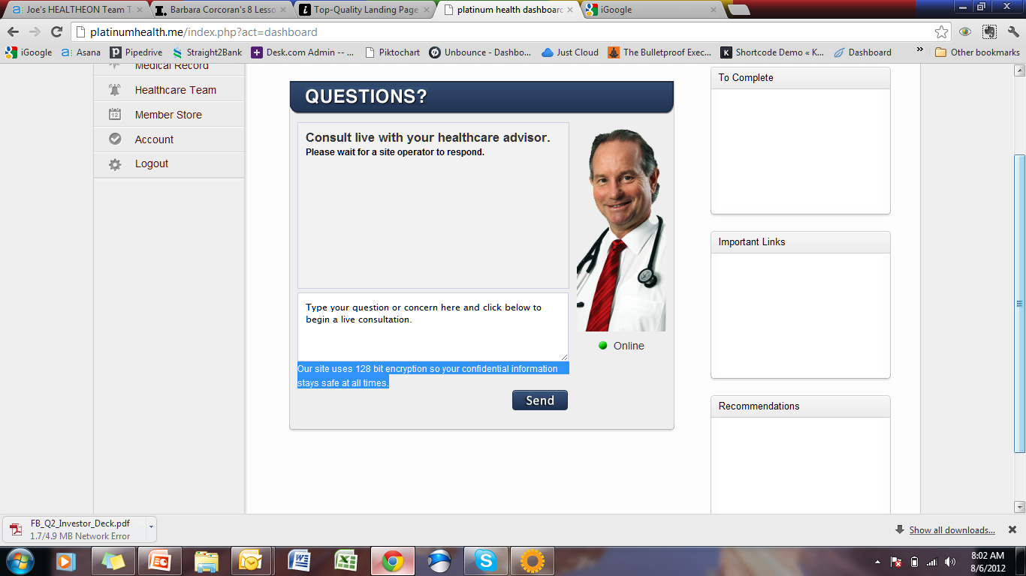

Remove and move here using the layout and icon
Completed
Our site uses 128 bit encryption. Completed
Your confidential information stays safe at all times.

Slide 3
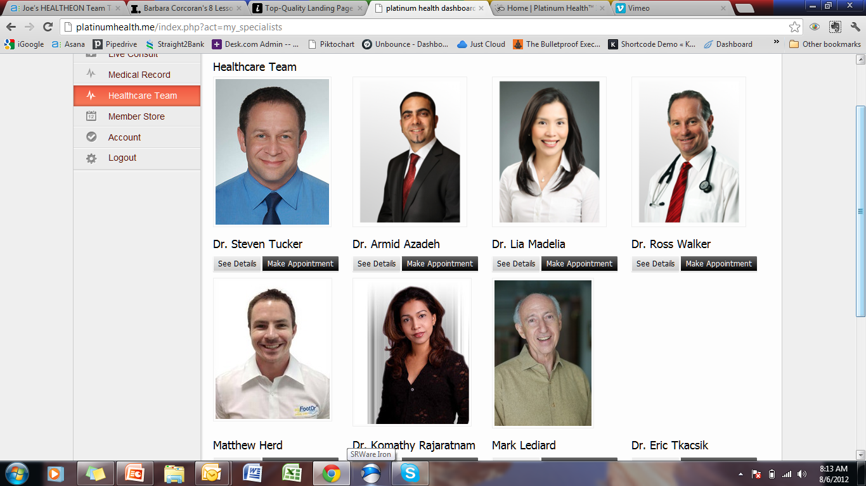
1) We need to be able to add their specialty below their name e.g
Dr. Steven Tucker
Internist - Oncologist
2) Change See Details to ‘Profile’ Completed

